Slide 1
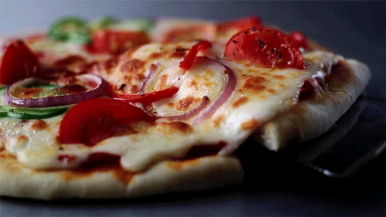
Pizza Sales Analysis

Slide 2
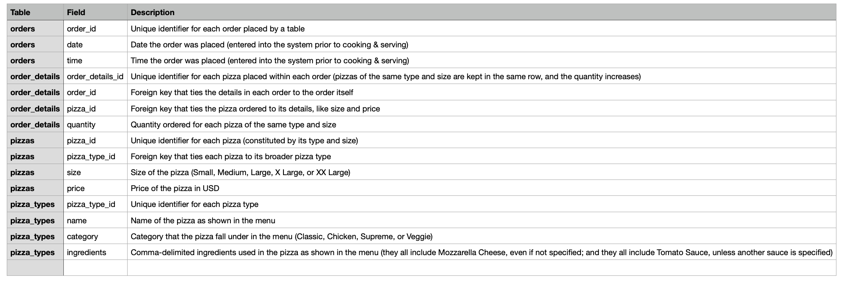
Data Set Description

Slide 3
Our objectives
Business Goal | Metrics | Level of details
Increase Revenue | Total Revenue (value and %) | Date(Q, M, Day) Pizza type, size, category
Increase Orders | Total Orders (value and %) | Date(Q, M, Day) Pizza type, size, category
Improve Productivity | Total Orders (value and %) | Date(Q, M, Day) Peak periods
Understanding customers’ purchase behaviour | Average Order Value | Date(Q, M, Day)
Best and Worst Selling Pizzas | Total Orders Total Revenue Total Sales | Pizza type, size, category, name

Slide 4
Questions to be answered
1. How many orders do we have each day?
2. What days and times do we tend to be busiest?
3. How many pizzas are we making during peak periods?
4. What are our best and worst selling pizzas?
5. Are there any pizzas we should take of the menu, or any promotions we could do?
6. How much money did we make?
7. Can we identify any seasonality in the sales?
8. What is our average order value?

